Slide 1

Liu Liu Megatech
Team 6..

Slide 3
Meet the team…

Slide 4
Gerda – Project Manager/Systems Analyst
Gabriel – Deputy project manager/Designer
Mugheeth – Designer/Tester
Patrick– Tester/Systems Analyst
Christopher – Programmer/designer
Edgar – Programmer/Systems Analyst
Although these were the roles that we took on, we helped each other where we could to increase productivity
Notes:
Introducing each of the members “our team” and the project we are working on which is BAPERS.
Explaining a bit about how the team
4

Slide 5
How the Project Went…

Slide 6
Started off with organising who wants to do which part of the 1st deliverable.
We set up to meet twice a week, one on the day of our consultant meeting (Thursday) and usually a Monday when we were all at university.
We divided up tasks for that week and set deadlines to ensure we were on top of tasks that were needed to be completed. We were able to check up on progress through GitHub and also through social media such as WhatsApp.

Slide 7
Problems encountered…

Slide 8
Maintaining consistency : when we were putting together our systems requirements document, we had made mistakes such as inconsistencies in our cases specs which did not match our GUI designs as an example
How they could be avoided in the future: Check each other’s work throughout the project to maintain consistency and spot mistakes instead of towards the end of the project.
Notes:
Consistency – SRD, there were issues with the use case specs as they didn’t match the GUI in terms of the functionalities.
We could have spent more dedicated time to making sure it was consistent. Spent more time checking the document.
With the GUI designs- we are missing functionalities that are required, there is a more suitable layout and a better user friendly approach.
8

Slide 9
Team Strategy

Slide 10
As a team we discussed on our main goal and what it would take to achieve that goal
We bonded as a group as we wanted each and every member of the team to feel comfortable and able to communicate their ideas
Defining strengths and weaknesses within the group

Slide 11
Teams Contributions
Christopher – ER diagram + Design Class, implementation
Edgar – SQL statements, implementation
Gabriel – GUI designs, GUI implementation
Gerda – SRD document, GUI implementation, presentation
Mugheeth – Testing/SRD document
Patryk – Testing/use case indexing
Group Contributions – Use Case diagram, use case specs
Notes:
Although we had our roles, we all contributed in other parts of the 1st deliverable. Checking over eachothers work etc
11

Slide 12
Lessons Learnt…

Slide 13
Organisational: setting deadlines and assuring the workload is spread evenly amongst team members.
Arranging meetings that are suitable for each team member
Project Management: keeping track of each team members progress throughout the project and also assuring good work is produced at the end of it.
Technical: Each team member made mistakes during the project when it came to designing diagrams but this was an opportunity to gain help from other team members to fix mistakes and avoid making future ones.

Slide 14
Looking into the Future…

Slide 15
Organizationally: meet up with the team more frequently in particular for 1st deliverable.
Technical: for the 1st deliverable we would not use GitHub because it was too complicated to use for certain team members. Google drive would have been useful as many people can work on a document at once and generally team member were more familiar using it.

Slide 16
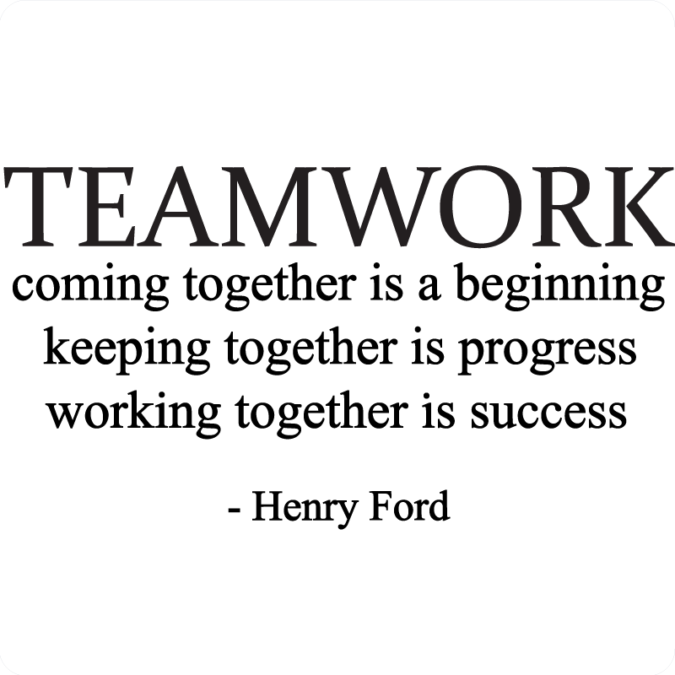
Our Teams Success

Slide 17
Finished use case diagram in 2 days working as a team
Got parts of the implementation working first time
Design class
Notes:
17

Slide 18
Challenges

Slide 19


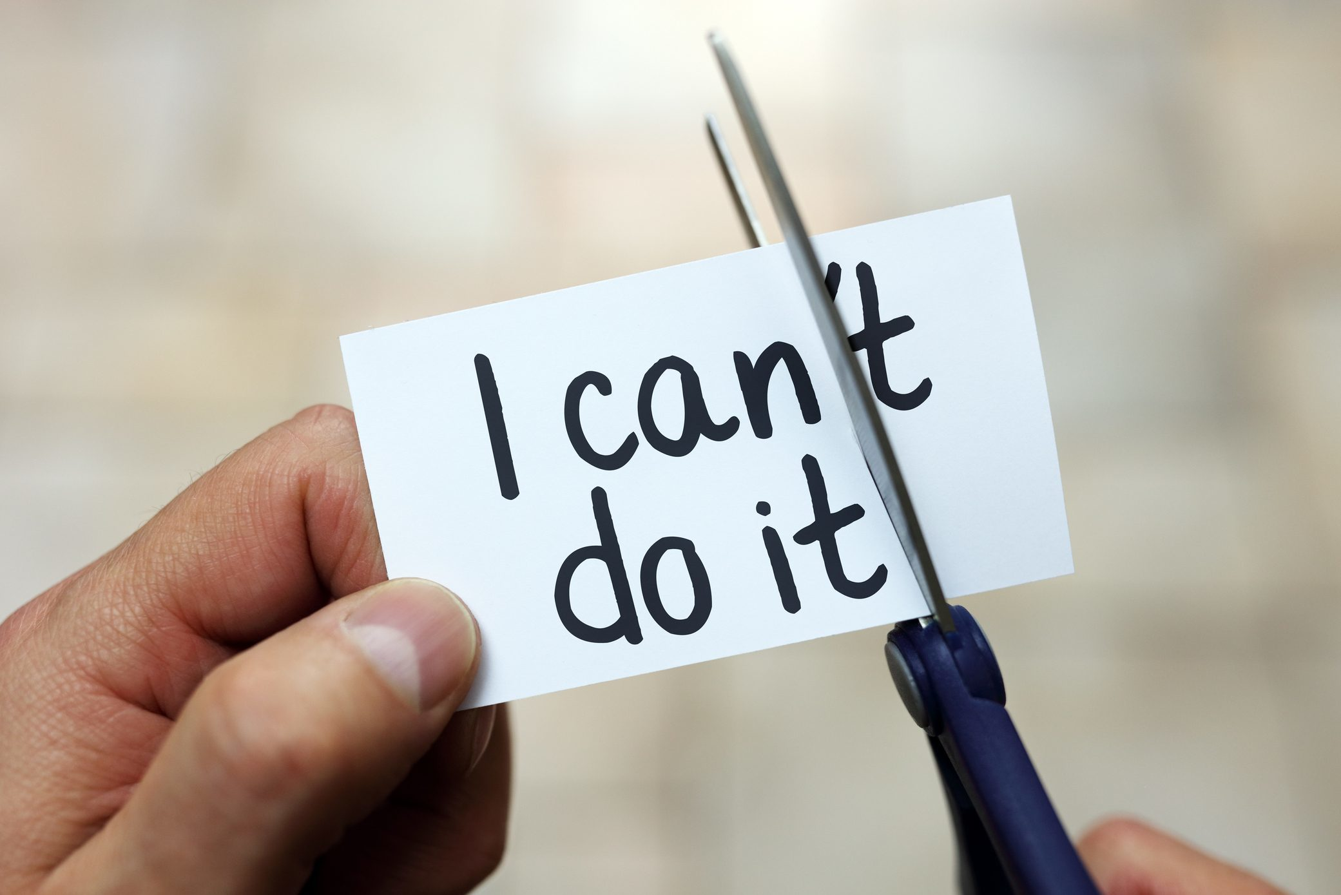
Database – SQL statements
Use case indexing: we had multiple versions and it took us a long time to create a final version
Changing the initial designs of the GUI from the 1st deliverable in the implementation to make sure all viable functionalities were covered
Notes:
Edgar redid it when we asked vlad the first time and then that resulted in more work
19

Slide 20
The presentation conclusion
Love.
Notes:
We are happy with the team m
20

